Slide 1
New Economic Geography
Empirical Analysis

Slide 2
Empirical analysis
Empirical Tests
Reduced form versus structural form
Reduced form:
wage = export/GDP + density + etc
Problem1: omitted bias
Problem2: not really a test of the model.
The model cannot be invalidated by this method. Only usefull to understand relationship (if omitted bias not too serious)

Slide 3
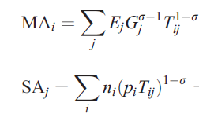
Redding and Venable
Multi-country version of Krugman and Venables (1995).
Theoretical wage equation: wage
With:

Slide 4
Market access (market potential) measures the export demand each country faces given its geographical position and that of its trading partners
Supplier access is the export supply each country faces given its geographical position and that of its trading partners

Slide 5
How to obtain ?
From exportation:
Xij=
Individual fixed effects used to obtain the predicted value of MA and SA.

Slide 6
Gravity equation

Slide 7
Second step: wage equation
Result: market access and supplier access measures are important determinants of income

Slide 8
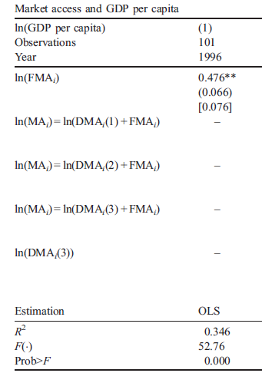
FMA alone explains approximately 35% of the cross-country variation in GDP per capita
MA appr 70%

Slide 9
Results
Access to the coast and open-trade policies yield predicted increases in per capita income of over 20%
Halving a country’s distance from all of its trade partners yields an increase of around 25%.
Foreign market access alone explains approximately 35% of the cross-country variation in GDP per capita

Slide 10
Conclusion
A success for the New Econ Geo, from theoretical to empirical analysis.
Explain well differences in GDP per capita between countries
Has been extended to various topics, in particular to explain wage, migration and FDI location choice.

