Slide 1
Divergence between small, middle and big cities
Lecture based on “The Faster Growth of Larger, Less Crowded Locations” of J Rappaport, Econ Review, 2018
Fabien Candau
Aim: To learn how to present stylized facts.
Indeed many good arguments are based on stylized facts, it is thus important to know how to find and how to present these facts.

Slide 2
Fact presented here: population and employment of small and large locations in the United States have been diverging.
Simple statistics: the average annual growth rate of locations’ population from 2000 to 2017 against the natural log of their population in 2000

Slide 3
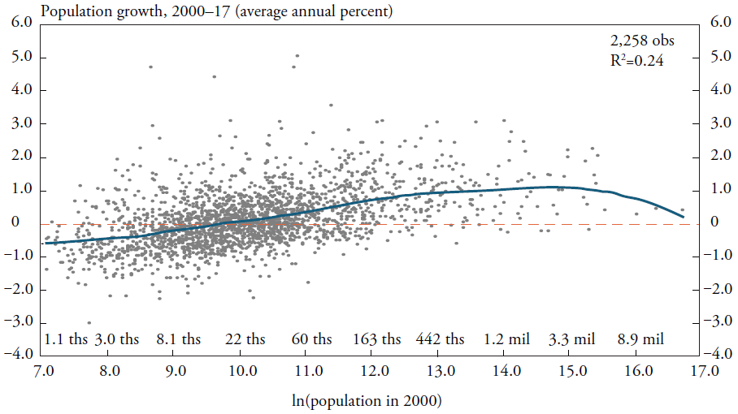
Divergence, the facts
Based on the whole sample, one can compute a smoothed average, which can be interpreted as the predicted rate of growth based on initial size.
Here the author uses a linear Epanechnikov kernel with a bandwidth of 1.5 log points (blue line).
The chart shows a positive relationship
between locations’ population growth
from 2000 to 2017 and the pop in 2000.

Slide 4
Divergence, the facts
At the bottom of the distribution, the predicted population growth rate = −0.6 percent per year, leading to a 0.6*17(years)= 10 percent cumulative loss in population from 2000 to 2017.
Here a pred growth of 1% year leading to a 17% cumulative gain in pop from 2000 to 2017.
Close to zero

Slide 5
Divergence, the facts
The metropolitan areas is divided into three groups: small (population up to 500,000), medium (population from 500,000 to 3 million), and large (population above 3 million)
Overall, a positive relationship but a bell-shaped relationship, the largest cities (around 9 million) have a smaller predicted growth than the biggest middle cities (around 3 million).
=> The effect of size is declining at the top of the distribution. Why? Increasing congestion costs? Declining agglomeration economies? Bad specialization (e.g. manufacturing)?
Small
Medium
Large
No details about the classification (rule of thumb: find a break or take at least 30 obs in each group)

Slide 6
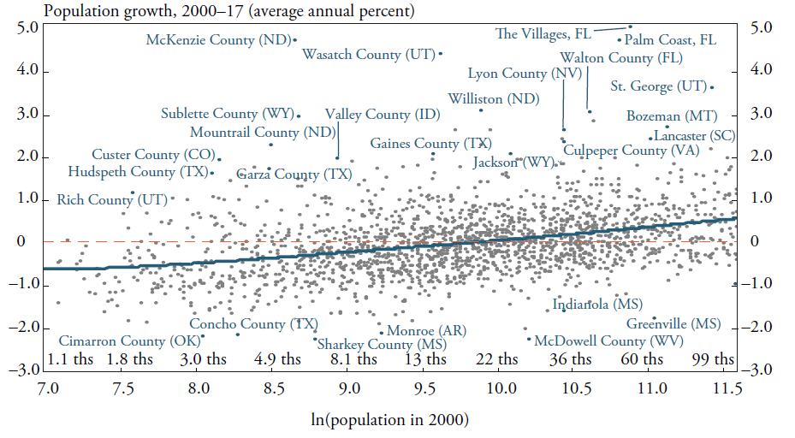
A zoom on small cities
Be careful: size does not explain everything: small size did not preclude rapid growth
The large vertical dispersion of the scatter above and below the average line reflects that characteristics other than initial size drove most of the variation in growth rates from 2000 to 2017.
Locations that grew fastest relative to their predicted are distinguished by:
Natural amenities (mountains, warm temp)
Proximity to large metropolitan areas
Benefitted from oil/gas deposits

Slide 7
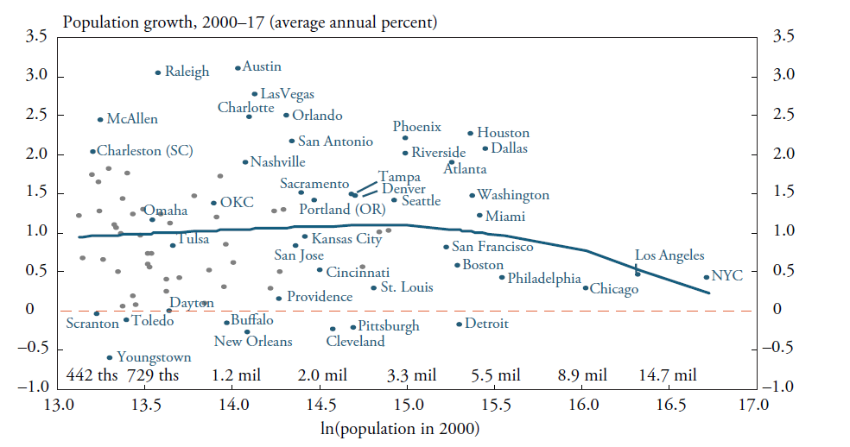
A zoom on middle and big cities
Be careful: size does not explain everything: large size did not preclude population decline
See below the dashed red line: Detroit, Pittsburgh and so on…
These cities are characterized by an industrial composition skewed heavily toward manufacturing, a sector in which employment has been contracting for many decades. The disadvantages of this inherited industrial composition are likely to have offset any benefits from size.

Slide 8
Conclusion
What to comment? => simple, concrete data. Example: you want to analyze trade liberalization, do not discuss a complex indicator of market access but an indicator that everyone can understand such as exportation on GDP.
How to comment?
Take the average and comment it at length, here we have commented a positive relationship between pop growth and size that is bell-shaped at the end of the distribution. We have also commented different part of this average distribution.
Take point that are far from the average, above and below, and comment these exceptions at length: here small cities that grow at a fast rate and big cities that decline.

